Slide 1
XCIST simulation & recon tests

Slide 2
Baseline for CatSim phantom experiments
Scanner
1-mm x 1-mm uniform focal spot
1-mm x 1-mm detector pixels
1 slice
¼-detector column offset
Physics
120 kV
Quantum noise off
Electronic noise off
Scatter off
2x2 source sampling
2x2 detector sampling
2x view sampling
Protocol
300 mA
1-s rotation
360 views
Phantom
1024x1024x1-pixel phantom
0.5 mm per XY pixel
16 mm per Z pixel
Scaled to 0.5
Therefore, phantom is 256 mm XY and 8 mm Z.
Recon
1 slice
1-mm slice thickness
300-mm FOV
No offset
Standard kernel
HU

Slide 3
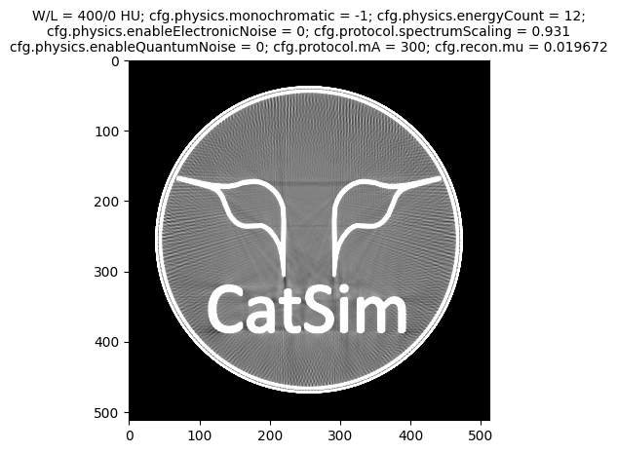
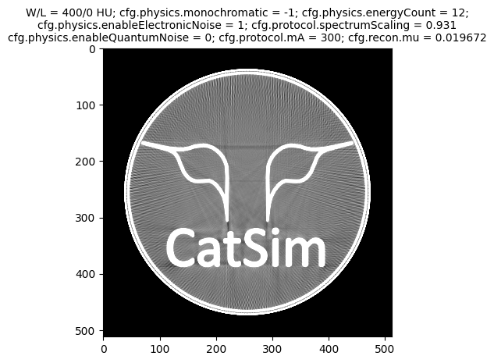


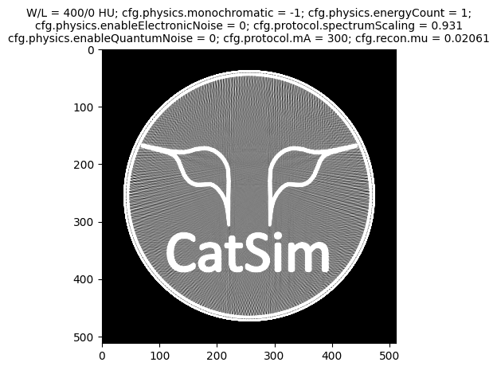

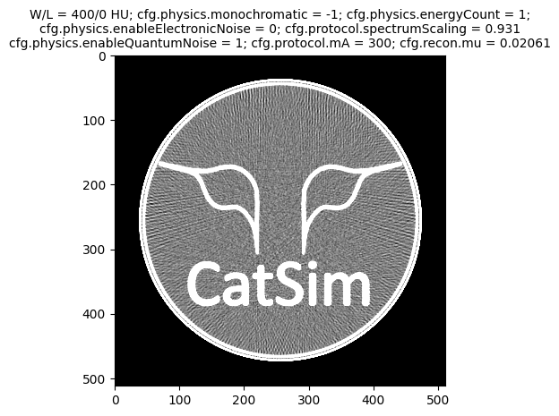
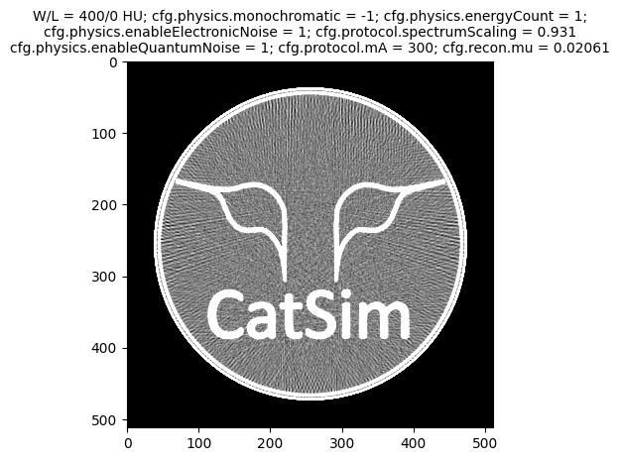


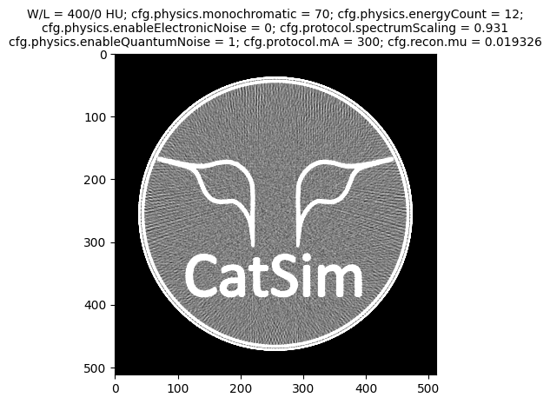

Noise evaluation – 300 mA, spectrum-specific mu
No noise
Electronic noise
Quantum noise
Quantum & electronic noise
Mean = 0.3 HU s.d. = 7.6 HU
Mean = 0.3 HU s.d. = 7.8 HU
Mean = 0.2 HU s.d. = 37.6 HU
Mean = 0.8 HU s.d. = 37.3 HU
Polyenergetic
1 energy bin
Mean = 0.0 HU s.d. = 8.2 HU
Mean = 0.0 HU s.d. = 9.0 HU
Mean = 0.5 HU s.d. = 40.7 HU
Mean = 0.0 HU s.d. = 39.9 HU
Mean = 0.0 HU s.d. = 6.2 HU
Mean = 0.0 HU s.d. = 6.5 HU
Mean = -0.5 HU s.d. = 34.1 HU
Mean = 0.1 HU s.d. = 34.7 HU
Monoenergetic

Slide 4


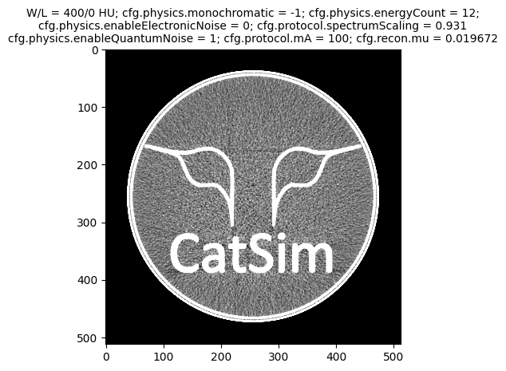
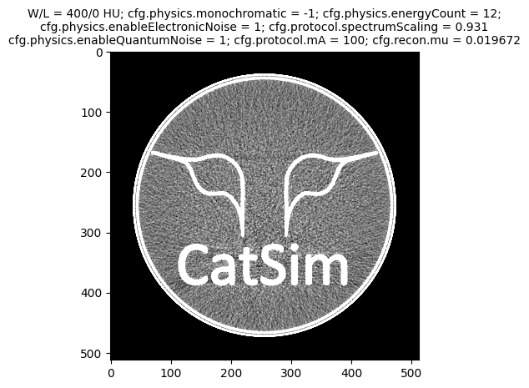
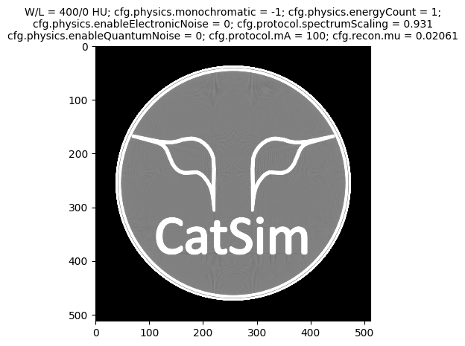

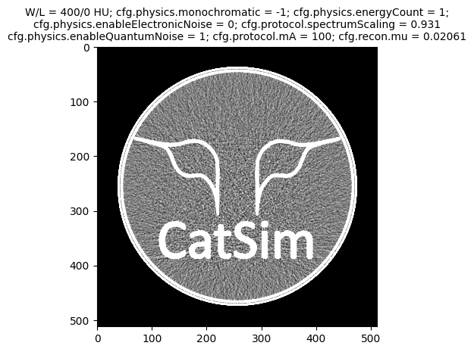
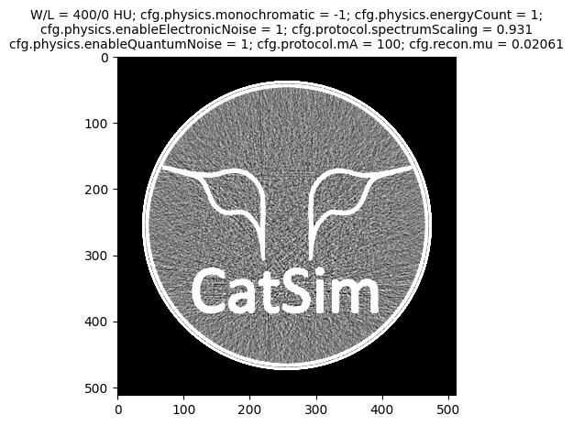


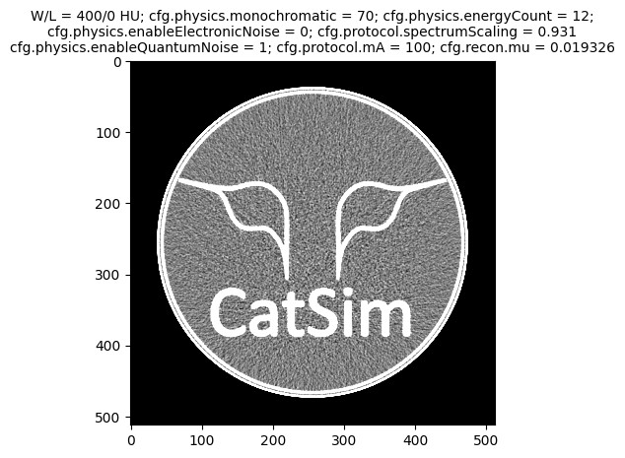
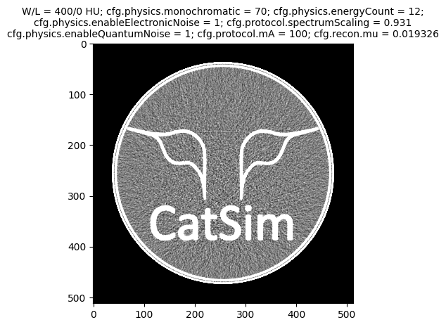
Noise evaluation – 100 mA, spectrum-specific mu
No noise
Electronic noise
Quantum noise
Quantum & electronic noise
Mean = 0.0 HU s.d. = 7.8 HU
Mean = 0.1 HU s.d. = 13.1 HU
Mean = 0.9 HU s.d. = 66.4 HU
Mean = 0.3 HU s.d. = 65.9 HU
Polyenergetic
1 energy bin
Mean = -0.1 HU s.d. = 6.5 HU
Mean = 0.1 HU s.d. = 20.2 HU
Mean = 1.4 HU s.d. = 69.7 HU
Mean = -1.4 HU s.d. = 70.1 HU
Mean = 0.0 HU s.d. = 5.3 HU
Mean = 0.3 HU s.d. = 12.8 HU
Mean = 0.3 HU s.d. = 60.7 HU
Mean = -0.2 HU s.d. = 62.4 HU
Monoenergetic

Slide 5
Noise evaluation – 100 mA, spectrum-specific mu #2
No noise
Electronic noise
Quantum noise
Quantum & electronic noise
Re-run no different
???
Mean = 0.0 HU s.d. = 7.8 HU
Mean = 0.1 HU s.d. = 13.1 HU
Mean = 0.9 HU s.d. = 66.4 HU
Mean = 0.3 HU s.d. = 65.9 HU
Polyenergetic
1 energy bin
Mean = -0.1 HU s.d. = 6.5 HU
Mean = 0.1 HU s.d. = 20.2 HU
Mean = 1.4 HU s.d. = 69.7 HU
Mean = -1.4 HU s.d. = 70.1 HU
Mean = 0.0 HU s.d. = 5.3 HU
Mean = 0.3 HU s.d. = 12.8 HU
Mean = 0.3 HU s.d. = 60.7 HU
Mean = -0.2 HU s.d. = 62.4 HU
Monoenergetic

Slide 6
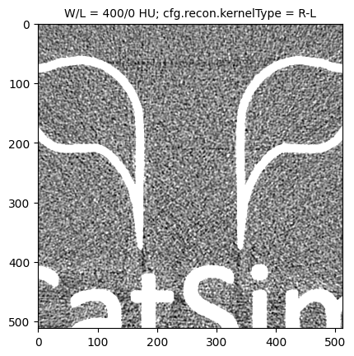
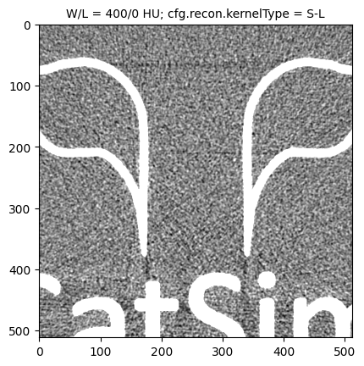
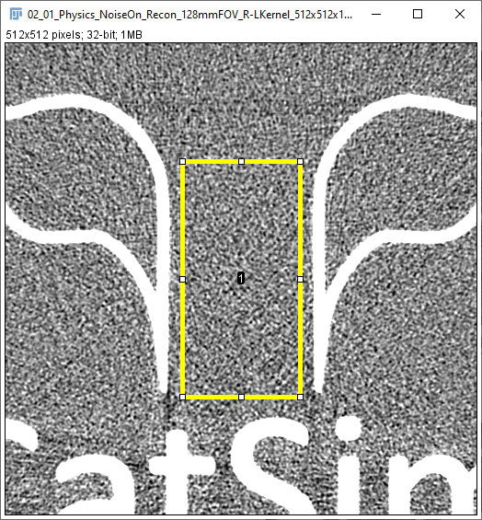
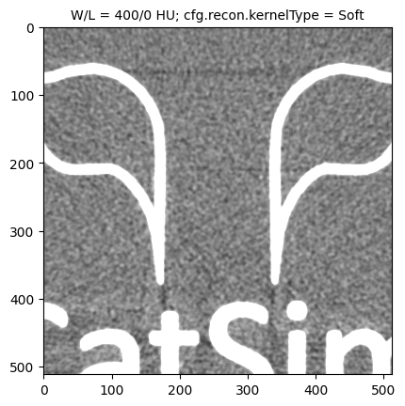
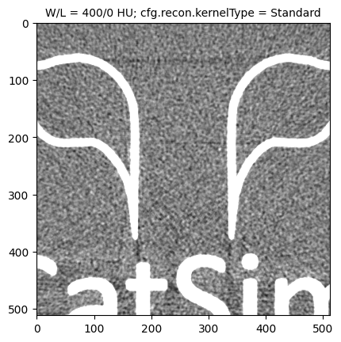

Recon kernel evaluation
R-L
S-L
Mean = 7.2 HU s.d. = 69.1 HU
Mean = 7.3 HU s.d. = 54.9 HU
Only a slight difference between R-L and S-L.
Also, these shift the mean differently than the other 3 kernels (using the same mu).
ROI
Soft
Standard
Bone
Mean = 0.3 HU s.d. = 24.5 HU
Mean = -0.1 HU s.d. = 37.7 HU
Mean = -0.2 HU s.d. = 76.9 HU

Slide 7



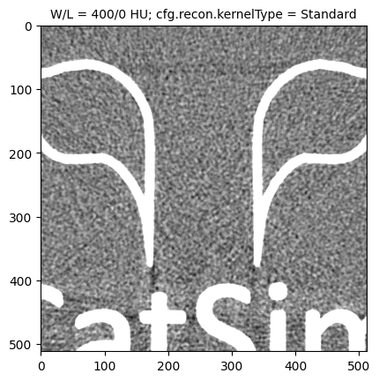

Recon kernel evaluation #2
Re-run - these are different ???
They all use the same projections…
R-L
S-L
Mean = 7.2 HU s.d. = 69.1 HU
Mean = 7.2 HU s.d. = 56.1 HU
Only a slight difference between R-L and S-L.
Also, these shift the mean differently than the other 3 kernels (using the same mu).
ROI
Soft
Standard
Bone
Mean = 0.2 HU s.d. = 24.1 HU
Mean = -0.2 HU s.d. = 38.7 HU
Mean = -0.3 HU s.d. = 78.5 HU

Slide 8
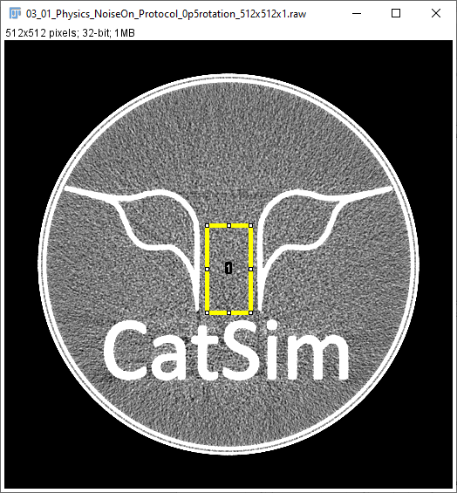
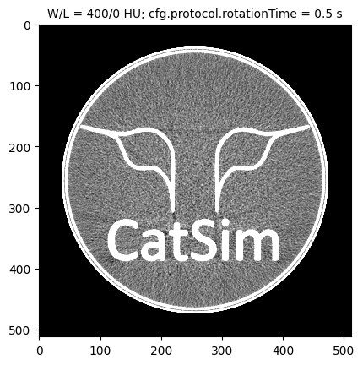


Rotation time evaluation
ROI
0.5 s
1.0 s
2.0 s
Mean = 0.0 HU s.d. = 53.6 HU
Mean = 0.0 HU s.d. = 37.2 HU
Mean = 0.0 HU s.d. = 27.3 HU

Slide 9
Rotation time evaluation #2
Re-run no different
???
ROI
0.5 s
1.0 s
2.0 s
Mean = 0.0 HU s.d. = 53.6 HU
Mean = 0.0 HU s.d. = 37.2 HU
Mean = 0.0 HU s.d. = 27.3 HU

Slide 10
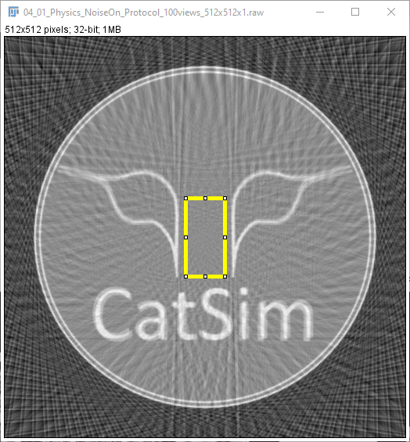
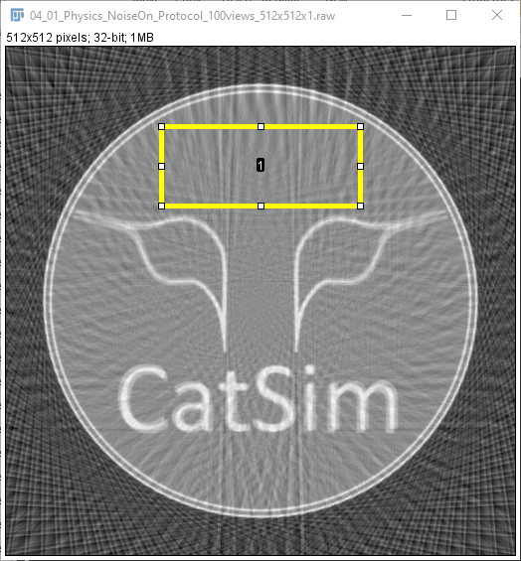
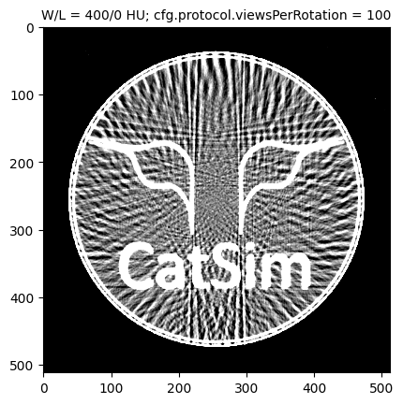
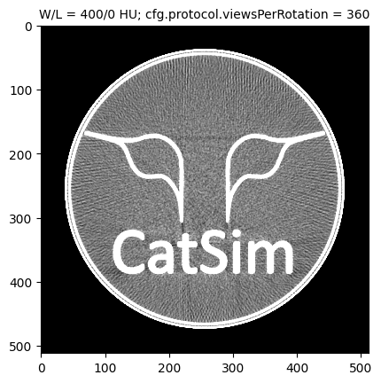

Number of views evaluation
ROI 1
ROI 2
100 views
360 views
1000 views
Mean = 0.9 HU s.d. = 65.5 HU
Mean = -9.8 HU s.d. = 133.5 HU
Mean = 0.2 HU s.d. = 38.6 HU
Mean = -9.6 HU s.d. = 44.1 HU
Mean = 0.6 HU s.d. = 39.0 HU
Mean = -9.8 HU s.d. = 32.0 HU

Slide 11
Number of views evaluation #2
ROI 1
Re-run no different
???
ROI 2
100 views
360 views
1000 views
Mean = 0.9 HU s.d. = 65.5 HU
Mean = -9.8 HU s.d. = 133.5 HU
Mean = 0.2 HU s.d. = 38.6 HU
Mean = -9.6 HU s.d. = 44.1 HU
Mean = 0.6 HU s.d. = 39.0 HU
Mean = -9.8 HU s.d. = 32.0 HU

Slide 12
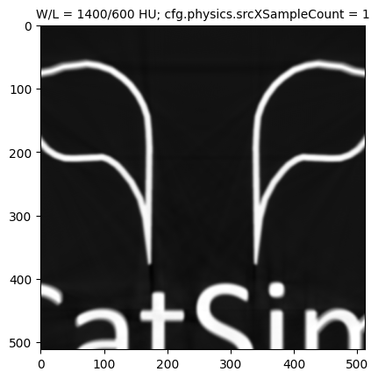


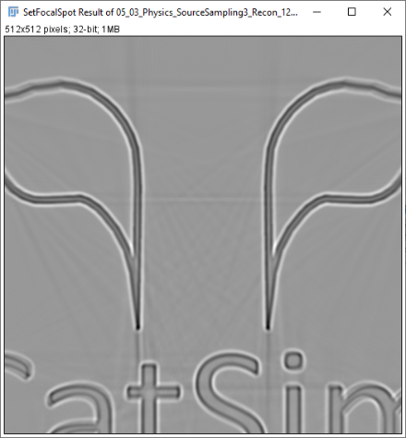



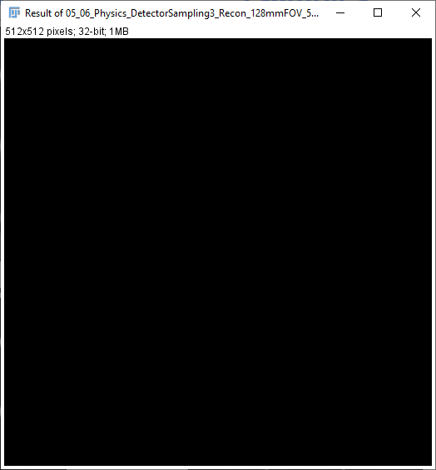
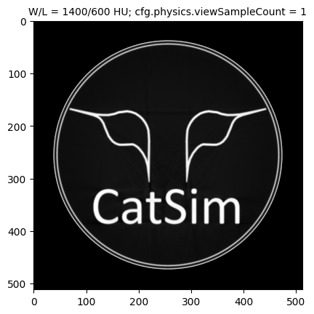


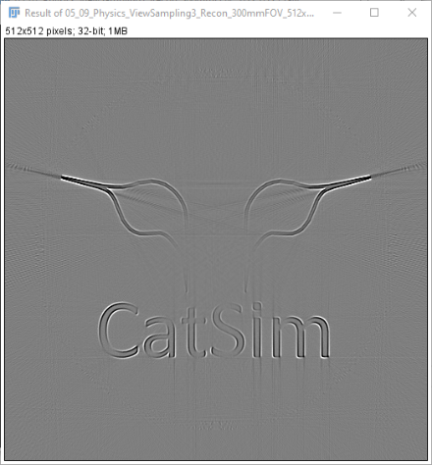
Sampling evaluation
1 sample
2 samples
3 samples
3 samples – 1 sample
Source
No effect from detector sampling is expected
Detector
View

Slide 13
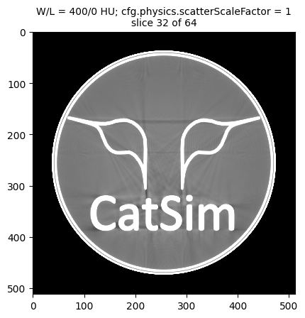
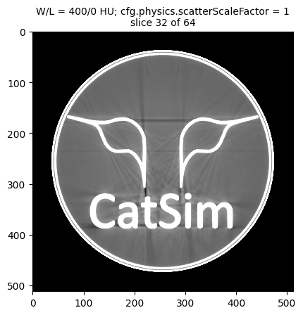
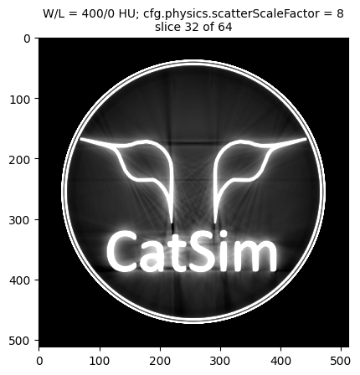
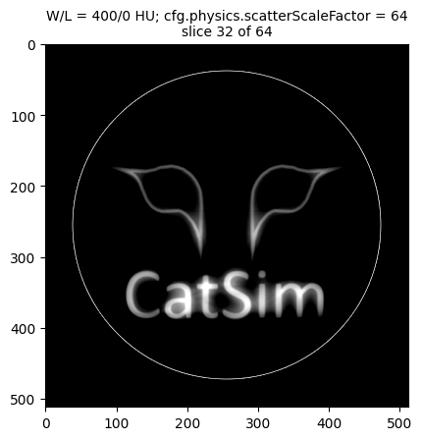
Scatter evaluation
No scatter
Scatter scale 1
Scatter scale 8
Scatter scale 64

Slide 14
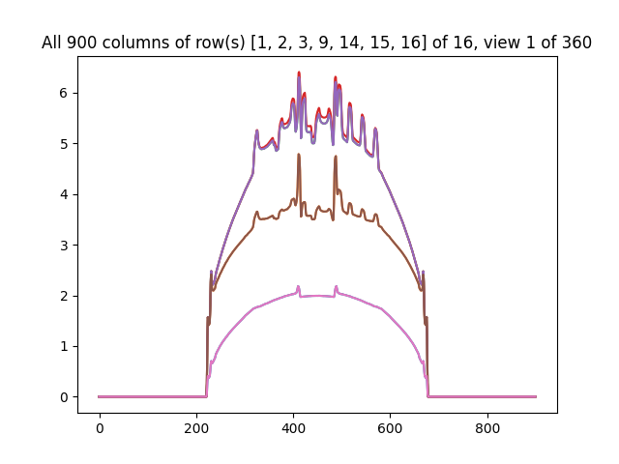
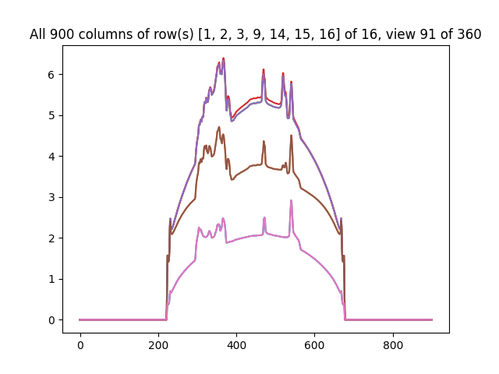
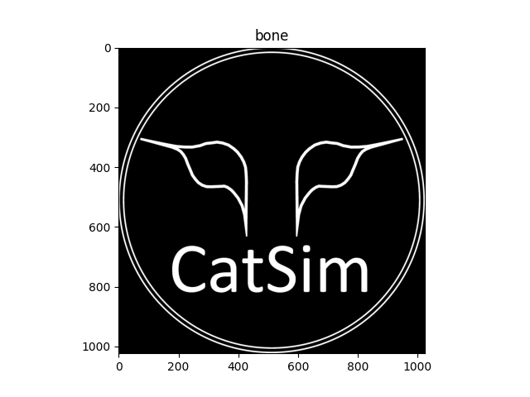
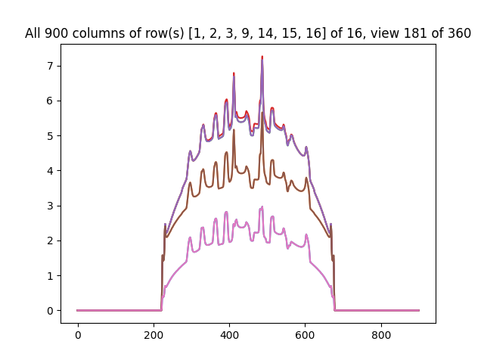
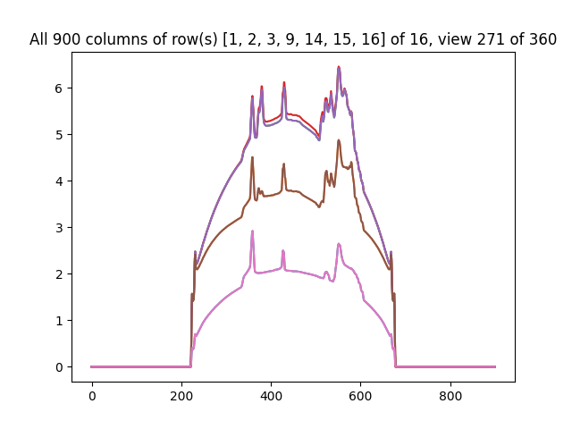
Baseline
16-row detector, 1-mm rows - > 9.095-mm Z FOV @ Z-axis
1024x1024x1-pixel phantom
Defined as 0.5 mm per XY pixel, and 16 mm per Z pixel, then scaled to 0.5. therefore, phantom is 256 mm XY and 8 mm Z.
View 181 Detector col 0…900
Outside of eye
Center of eyes
im
View 271 Detector col 0…900
View 91 Detector col 0…900
View 1 Detector col 0…900
CatSim but no eyes
outside of eye
Ca
Center of eyes

Slide 15
16 slices, no phantom offset
16-slice recon, 1-mm slices, 300-mm FOV
We expect:
2 blank slices on each end (slices 1, 2, 15, 16)
3 slices on each half with phantom partially exposed; symmetrical (i.e., slices 3 = slice 14 ; slice 4 = slice 13 ; slice 5 = slice 12)
6 complete slices (slices 6-11)

Slide 16
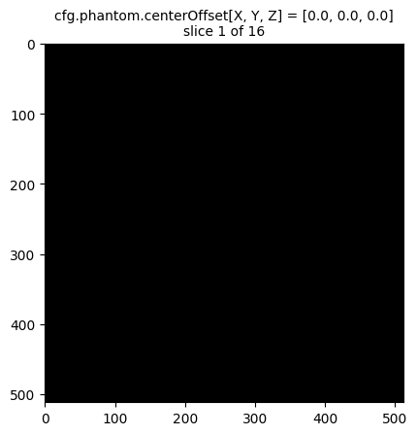
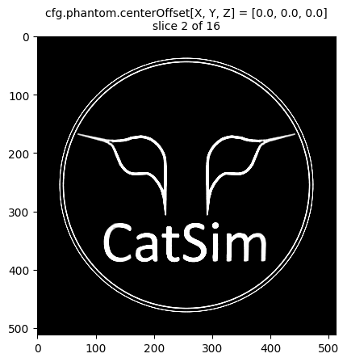
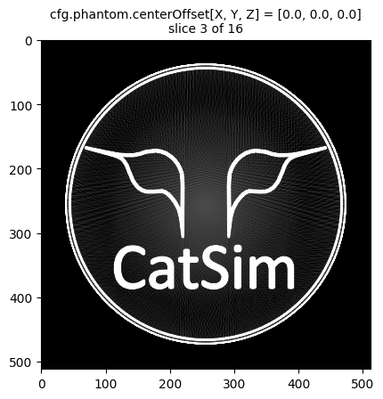
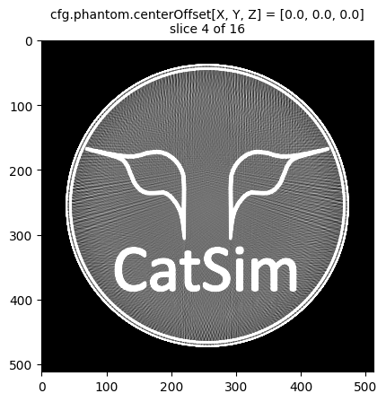
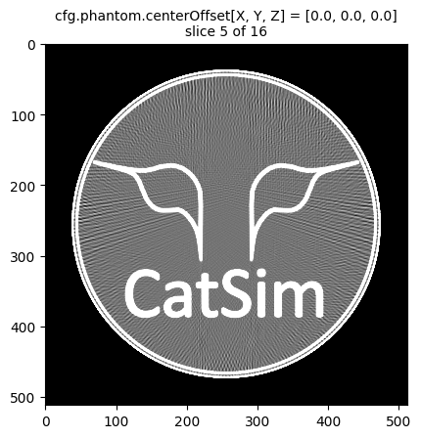




16 slices, no phantom offset
16-slice recon, 1-mm slices, 300-mm FOV
Expected each end to have 2 blank + 3 partial, with partials symmetrical in Z.
Got 1 blank slice + 3 partial, with partials symmetrical in Z.
300 mm
256 mm

Slide 17
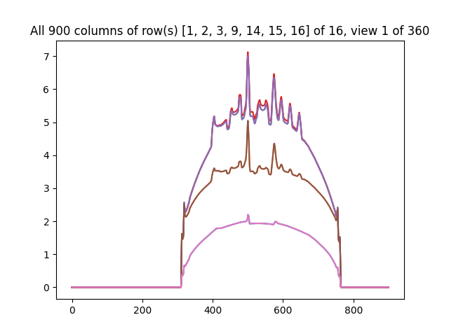
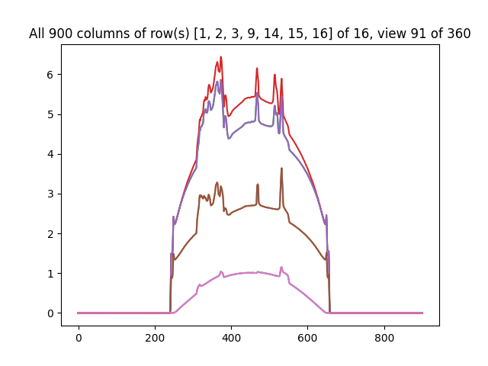
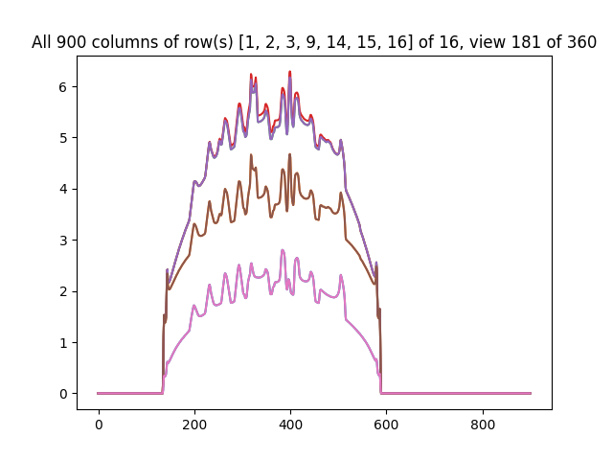
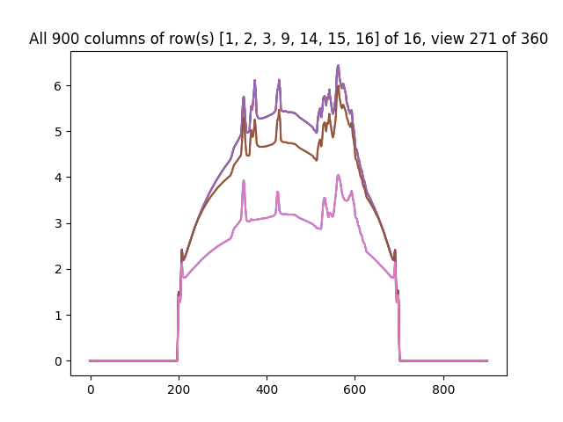
16 slices, phantom offset +50-mm X
+X offset moves the phantom to the right – good!
16-row detector, 1-mm rows - > 9.095-mm Z FOV @ Z-axis
1024x1024x1-pixel phantom
Defined as 0.5 mm per XY pixel, and 16 mm per Z pixel, then scaled to 0.5. therefore, phantom is 256 mm XY and 8 mm Z.
View 181 Detector col 0…900
m
Corner of eye
View 271 Detector col 0…900
View 91 Detector col 0…900
View 1 Detector col 0…900
Center of eyes

Slide 18
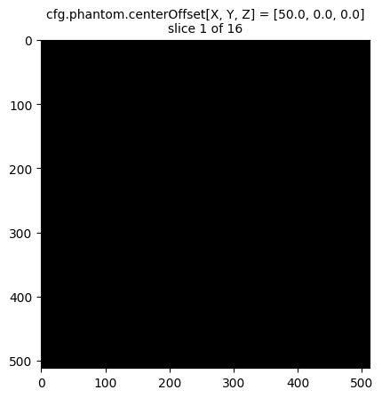
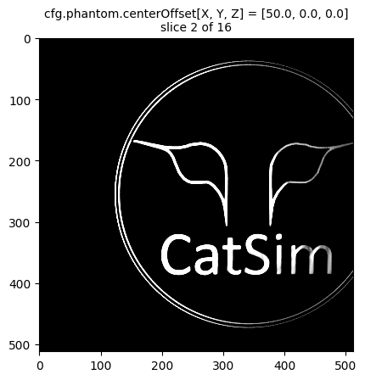







16 slices, phantom offset +50-mm X
Expected each end to have 2 blank + 4 partial, with partials symmetrical in Z.
Got 1 blank slice + 3 partial, with partials asymmetrical in Z.
300 mm
50 + 22 mm
So phantom offset is applied after the scaling – good!

Slide 19




16 slices, phantom offset +50-mm Y
+Y offset moves the phantom up – good!
16-row detector, 1-mm rows - > 9.095-mm Z FOV @ Z-axis
1024x1024x1-pixel phantom
Defined as 0.5 mm per XY pixel, and 16 mm per Z pixel, then scaled to 0.5. therefore, phantom is 256 mm XY and 8 mm Z.
View 181 Detector col 0…900
CatS
View 271 Detector col 0…900
View 91 Detector col 0…900
View 1 Detector col 0…900
Center of eyes
Bottom edge of CatSim

Slide 20









16 slices, phantom offset +50-mm Y
16-slice recon, 1-mm slices, 300-mm FOV
Expected each end to have 2 blank + 4 partial, with partials symmetrical in Z.
Got 1 blank slice + 3 partial, with partials symmetrical in Z.
Slices 5-12
50 + 22 mm

Slide 21




16 slices, phantom offset +4-mm Z
+Z offset moves the phantom to a higher-numbered detector row – good!
16-row detector, 1-mm rows - > 9.095-mm Z FOV @ Z-axis
1024x1024x1-pixel phantom
Defined as 0.5 mm per XY pixel, and 16 mm per Z pixel, then scaled to 0.5. therefore, phantom is 256 mm XY and 8 mm Z.
Row 9
View 181 Detector col 0…900
Row 8 (and 1-7)
View 271 Detector col 0…900
View 91 Detector col 0…900
View 1 Detector col 0…900
Center of eyes

Slide 22




16 slices, phantom offset +4-mm Z
+Z offset moves the phantom to a lower-numbered slice – slice numbering needs to be reversed. Could do that by flipping the array, but more efficient if the array is written in the opposite Z order in C.
Expected one end to have 2 blank + 4 partial + 2 complete,
Got 0 blank slices + 2 partial + 6 complete.
3-8 all complete:
9-16 all blank:

Slide 23




16 slices, phantom offset +8-mm Z
+Z offset moves the phantom to a higher-numbered detector row – good!
16-row detector, 1-mm rows - > 9.095-mm Z FOV @ Z-axis
1024x1024x1-pixel phantom
Defined as 0.5 mm per XY pixel, and 16 mm per Z pixel, then scaled to 0.5. therefore, phantom is 256 mm XY and 8 mm Z.
16
View 181 Detector col 0…900
15
14
Row 13
View 271 Detector col 0…900
View 91 Detector col 0…900
View 1 Detector col 0…900
Center of eyes

Slide 24






16 slices, phantom offset +8-mm Z
16-slice recon, 1-mm slices, 300-mm FOV
Expected one end to have 2 blank + 2 partial, with remaining 12 blank.
Got all blank slices except slice 1.

Slide 25







16 slices, no phantom offset
16-slice recon, 0.5-mm slices, 300-mm FOV
Expected each end to have 0 blank + 6 partial, with partials symmetrical in Z.
Got 0 blank slices + 3 partial, with partials symmetrical in Z.

Slide 26





16 slices, no phantom offset, +1-mm-Z recon offset
Looks almost OK but not quite. Slices 1-2 look OK (match slices 3-4 on prior slide) but slices 12-14 don’t match slices 14-16 on prior slide.
16-slice recon, 0.5-mm slices, 300-mm FOV

Slide 27



Recon offset
Spec’d +22-mm X
Spec’d +22-mm Y
Moved +22 mm X.
Moved 22 mm Y.
No offset

